Slide 1
Applied Machine Learning and Data Mining
Week 7: Exploratory Data Analysis & Visualization
Dr. Alaa Mohasseb

Slide 2
Last Week
Learn What is Data preprocessing?
Identify the importance of data preprocessing
Understand how to apply data Cleaning

Slide 3
Outline for Today
Learn what is Data Analysis
Gain an understanding of the different types Data Analysis
Understand what is Data Visualization
Learn about the types of data visualization charts
Identify what makes a good visualization

Slide 4
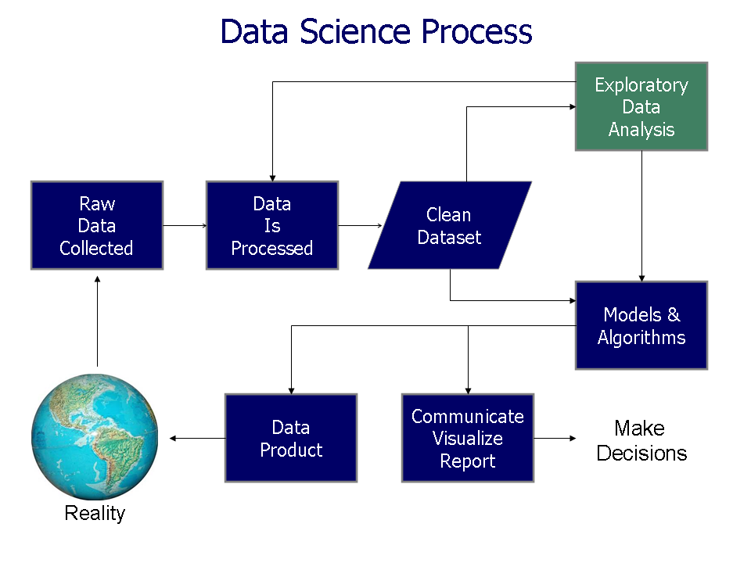
Exploratory Data Analysis
Source: https://upload.wikimedia.org/wikipedia/commons/b/ba/Data_visualization_process_v1.png
Notes:
Collect data: This could involve collecting data from electronic health records, medical imaging devices, or wearable devices. For example, a data scientist might collect data on patient demographics, medical conditions, treatments, and outcomes.
Clean and prepare the data: This could involve removing errors, inconsistencies, and outliers from the data. For example, a data scientist might remove duplicate records, correct spelling errors, and convert all dates to the same format.
Exploratory data analysis (EDA): This involves using statistical methods and visualization techniques to explore the data and identify patterns and trends. For example, a data scientist might create histograms, scatter plots, and boxplots to visualize the distribution of different variables.
Model building and evaluation: This involves using machine learning or deep learning algorithms to build models that can predict or classify data. For example, a data scientist might build a model to predict a patient's risk of developing a certain disease.
Communicate and visualize the results: This involves sharing the findings of the data analysis with stakeholders in a way that is clear and easy to understand. For example, a data scientist might create a presentation or report that includes charts, graphs, and tables.

Slide 5
What is Data Analytics?
Data analytics is the process of examining, cleaning, transforming, and interpreting data to discover valuable insights and make informed decisions. It's like using information to better understand a situation or solve a problem in the real world.
Let's break it down with a practical example:
Imagine you own a small ice cream shop, and you want to figure out which flavors of ice cream are the most popular among your customers. This is where data analytics comes into play:
Data Collection: You start by collecting data, such as the number of scoops sold for each flavor of ice cream over the past month. This data could be stored in a spreadsheet or a simple record book.
Data Cleaning: You might notice some inconsistencies or errors in your data, like misspelled flavor names or missing entries. Data cleaning involves fixing these issues to ensure your data is accurate and reliable.
Data Transformation: Next, you might want to organize your data in a way that's easier to work with. You could create a chart or graph that shows the popularity of each flavor.
Data Analysis: Here's where the real magic happens. You use data analysis techniques to examine the information you've collected. For example, you might notice that chocolate and vanilla ice cream are the best-sellers, while strawberry is less popular.
Interpretation: With your analysis, you can now interpret the data. In this case, you conclude that chocolate and vanilla are the most popular flavors among your customers.
Decision-Making: Armed with this insight, you can make informed decisions for your ice cream shop. You might decide to order more chocolate and vanilla ice cream, offer promotions on those flavors, or even create new flavors based on the customer preferences.
So, data analytics is like a tool that helps you turn raw data into useful information, allowing you to make smarter choices in your business or personal life. It's not just about numbers; it's about understanding patterns, making predictions, and improving your decision-making processes.
Process
01.
Inspect, cleanse, transform, and model the data to discover useful information to support decision-making
02.
Science
Analyse raw data in order to make conclusions about that information
Techniques
03.
Reveal trends and metrics that can used to optimise processes to increase the overall efficiency of a business or system

Slide 6




Types of Data Analytics
Descriptive
Diagnostic
Predictive
Prescriptive
Explains what happened
Explains why it happened
Forecast what might happen
Recommends an action based on the forecast

Slide 7





Predictive Analytics
Predictive analytics is like using data and math to make educated guesses about the future. It looks at past information to forecast what might happen next. For example, it can predict which movies you might like based on your previous choices or estimate how many products a store will sell next month by analyzing past sales data. It's all about using data to make smarter decisions and anticipate outcomes
Forecasting
Classification
Predictive analytics combines various data analysis techniques such as data mining, machine learning, and many more.
Regression
Predictive Analytics
Text Analysis
Machine Learning
Source: Redwoodslogistics.com

Slide 8
Why is data Analysis important?
In summary, data analysis is crucial because it turns data into actionable insights, helps solve problems, and enables data-driven decision-making, which can lead to improved efficiency, competitiveness, and overall success in various fields and industries
Helps to uncover the underlying structure of the dataset, identify important variables,
Detect outliers and anomalies, and test underlying assumptions.
Identify relevant variables
transformations, and interaction among variables with respect to the model to be built.
Point out missing data
It exposes trends, patterns, and relationships that are not readily apparent.
Understand the relationships between different key variables
Lead to the selection of an appropriate predictive model.
It is a crucial step to making sure you have the perfect dataset because it sets the stage for more advanced analysis, like machine learning and data modelling. EDA is crucial because it provides the necessary context you need to answer your business questions.

Slide 9
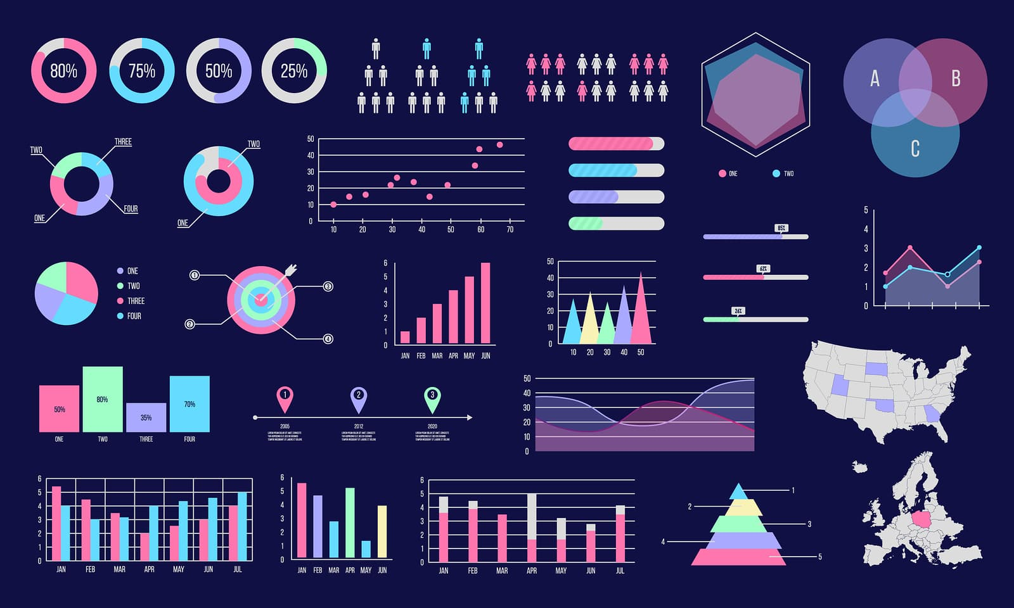
Data Visualization
The act of taking information (data) and placing it into a visual context, such as a map or graph.
Data visualization is important in finance, marketing, tech, design, or anything else, you need to visualize data.
Source: Edsys.in

Slide 10
Why is Data Visualisation Important?
Provides an idea of what the information means
Easy data interpretation
Identifies patterns, trends and outliers

Slide 11
Why data visualization is important?
It allows trends and patterns to be more easily seen.
Help to easily interpret increasingly larger batches of data.
Machine learning makes it easier to conduct analyses such as predictive analysis, which can then serve as helpful visualizations to present.

Slide 12
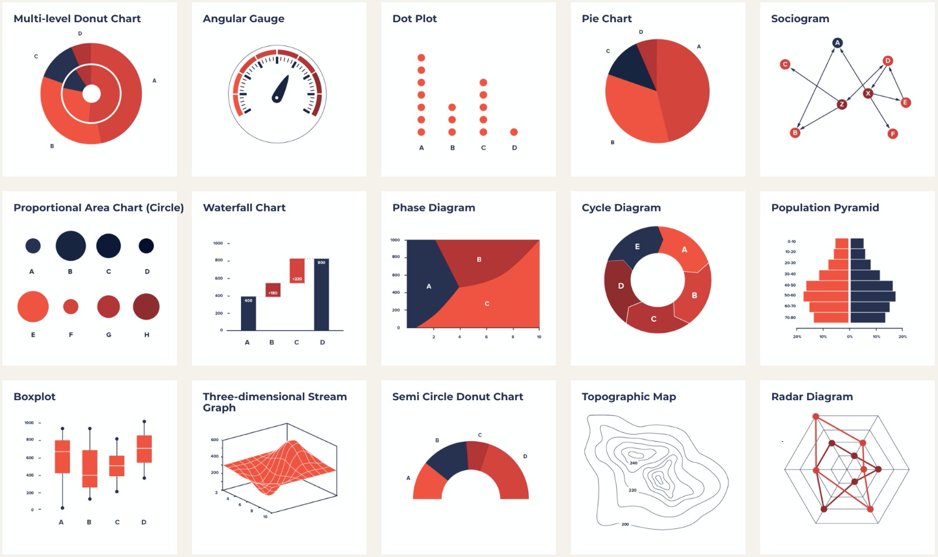
Types of data visualization charts
Histograms: to check the distribution of a specific variable
Scatter plots: to check the dependency between two variables
Maps: to show distribution of a variable on a regional or world map
Feature correlation plot (heatmap): to understand the dependencies between multiple variables
Time series plots: to identify trends and seasonality in time dependent data
Source:4833.1523705164.jpg

Slide 13
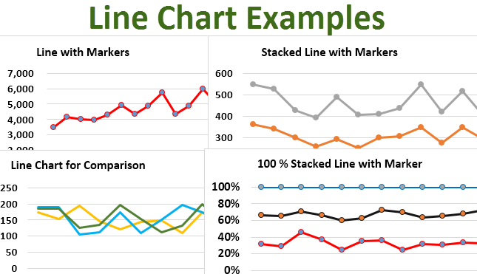
Line chart
A line chart illustrates changes over time.
The x-axis is usually a period of time, while the y-axis is quantity.
E.g this could illustrate a company’s sales for the year broken down by month or how many units a factory produced each day for the past week.
Source:Line-Chart-Examples.png

Slide 14
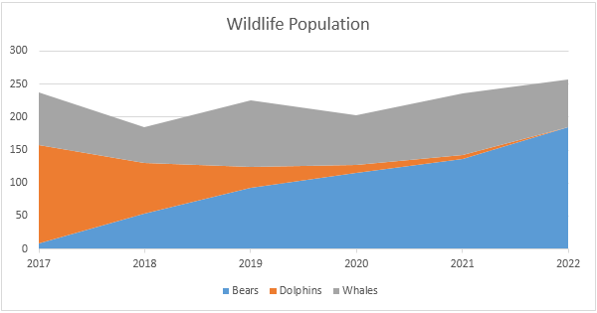
Area Chart
An area chart is an adaptation of a line chart where the area under the line is filled in to emphasize its significance.
The color fill for the area under each line should be somewhat transparent so that overlapping areas can be discerned.
Source:area-chart.png

Slide 15
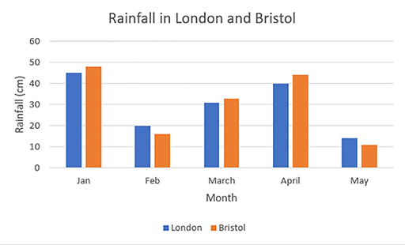
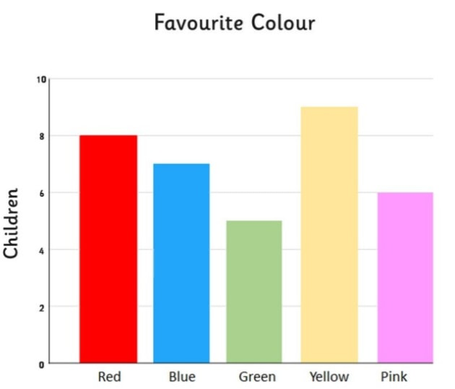
Bar Chart
A bar chart also illustrates changes over time. But if there is more than one variable, a bar chart can make it easier to compare the data for each variable at each moment in time.
For example, a bar chart could compare the company’s sales from this year to last year.
Source:barchart_ver_1.jpg
Source:wk8_fig19.tif.jpg

Slide 16
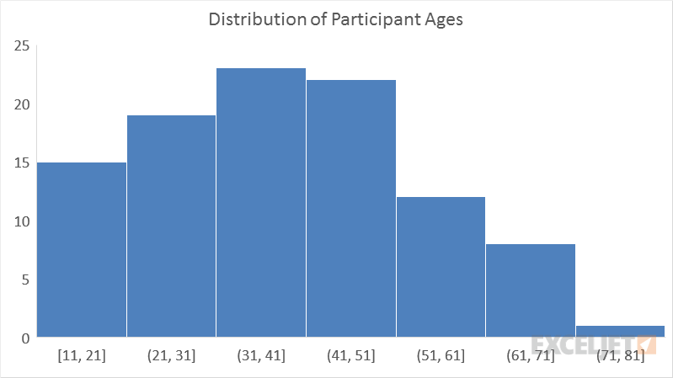
Histogram
A histogram looks like a bar chart, but measures frequency rather than trends over time.
The x-axis of a histogram lists the “bins” or intervals of the variable, and the y-axis is frequency, so each bar represents the frequency of that bin.
For example, measure the frequencies of each answer to a survey question. The bins would be the answer: “unsatisfactory,” “neutral,” and “satisfactory.” This would tell you how many people gave each answer.
Source:histogram chart.png

Slide 17
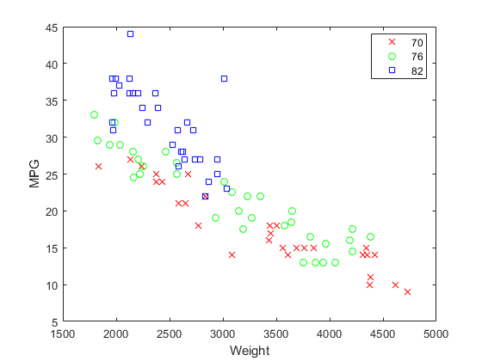
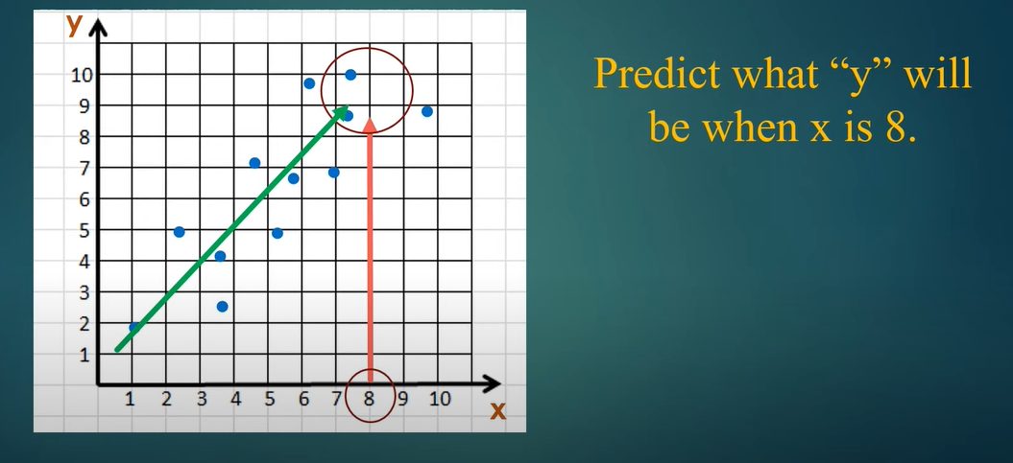
Scatter Plot
Scatter plots are used to find correlations.
Each point on a scatter plot means “when x = this, then y equals this.”
That way, if the points trend a certain way (upward to the left, downward to the right, etc.) there is a relationship between them.
If the plot is truly scattered with no trend at all, then the variables do not affect each other at all.
Source:CreateScatterPlotsUsingGroupedDataExample_01.png

Slide 18
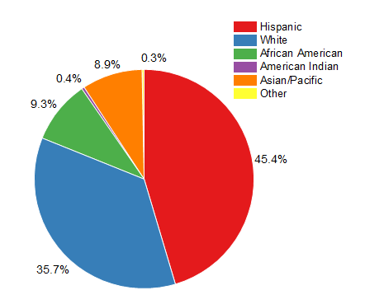
Pie Chart
A pie chart is the best option for illustrating percentages, because it shows each element as part of a whole.
For example, If the data explains a breakdown in percentages, a pie chart will clearly present the pieces in the proper proportions.
Source:2D_B_W_Pie_Chart_1.png

Slide 19
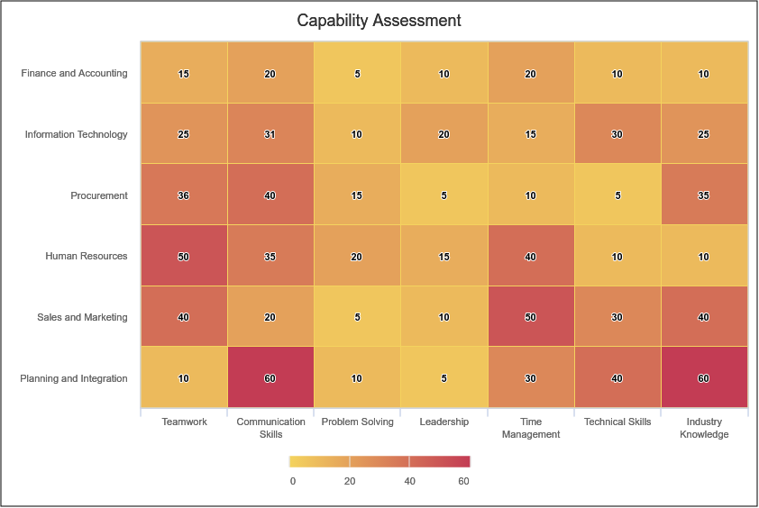
Heat Map
A heat map is basically a color-coded matrix.
A formula is used to color each cell of the matrix is shaded to represent the relative value or risk of that cell.
Usually heat map colors range from green to red, with green being a better result and red being worse.
This type of visualization is helpful because colors are quicker to interpret than numbers.
Source: 5bc54470-b71d-4ed6-8586-4063b4ebfeb8.png

Slide 20
Good vs Bad Visualization
What makes a good visualization?

Slide 21
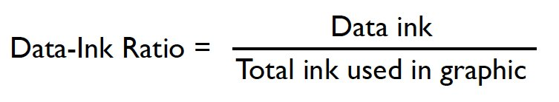
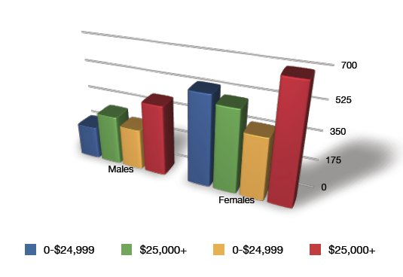
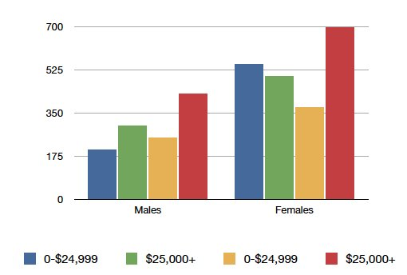
Maximize Data-Ink Ratio

Slide 22
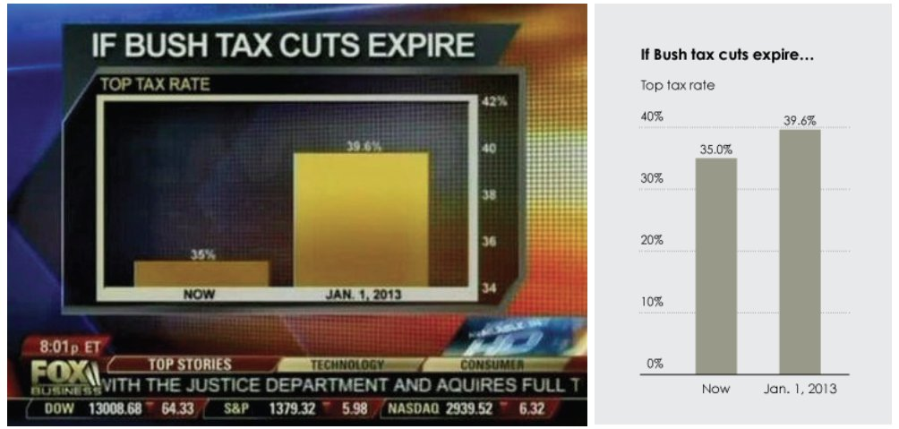
Graphical Integrity: Scale Distortion
Always start bar graphs at zero.
Always properly label your axes.
Use continuous scales: linear or labelled!

Slide 23
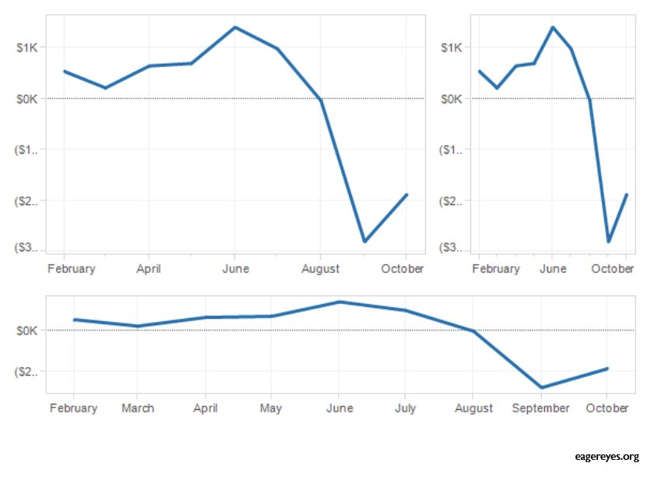
Aspect Ratios and Lie Factors
The steepness of apparent cliffs is a function of aspect ratio.
Aim for 45° lines or Golden ratio as most interpretable.
Golden ratio, width = 1.6 height

Slide 24
Reduce Chartjunk
Visual elements in charts and graphs that are not necessary to comprehend the information represented on the graph.
Extraneous visual elements distract from the message the data is trying to tell.
Extra dimensionality
Uninformative coloring
Excessive grids and figurative decoration
In an exciting graphic, the data tells the story, not the chartjunk.

Slide 25
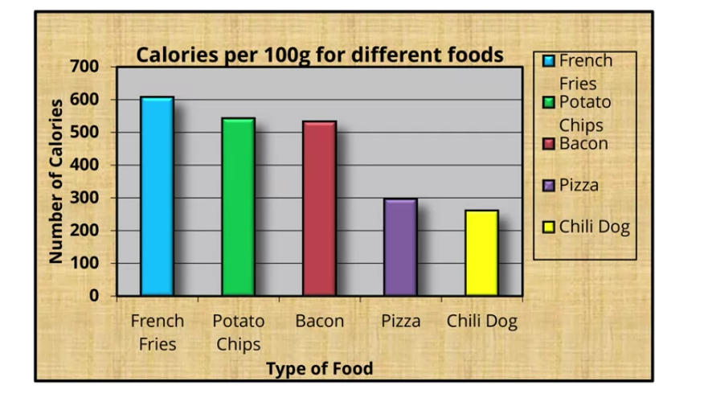
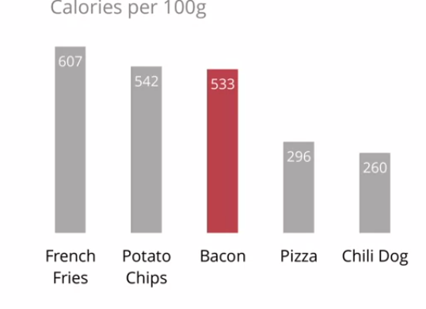
Chartjunk Example
Chart with Chart Junk
Chart with reduced Chart Junk
Further Reading: Chart Junk: How to Avoid it?

Slide 26
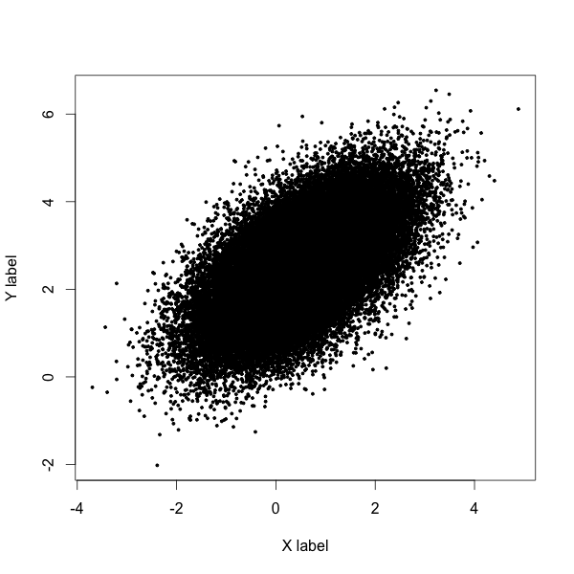
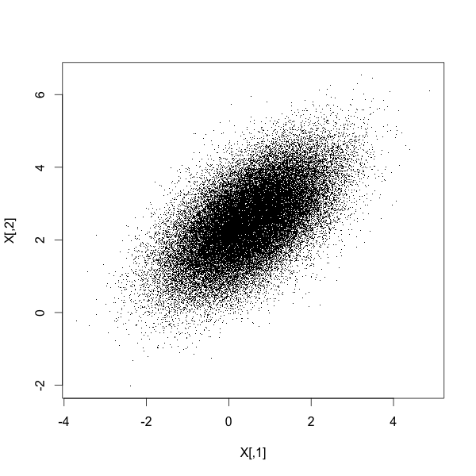
Reduce Overplotting by Small Points

Slide 27
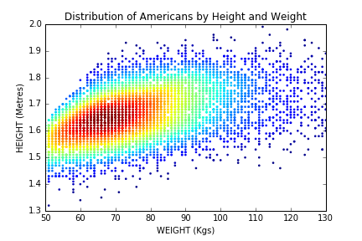
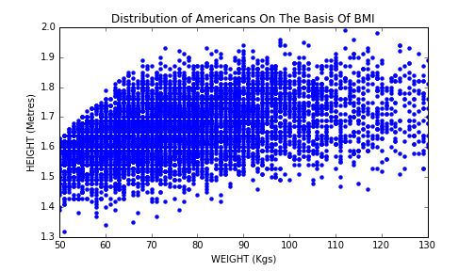
Heatmaps Reveal Finer Structure
Color points on the basis of frequency

Slide 28
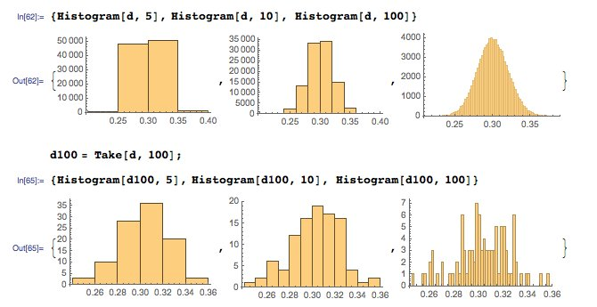
Histograms: Bin Size / Count Matters

Slide 29
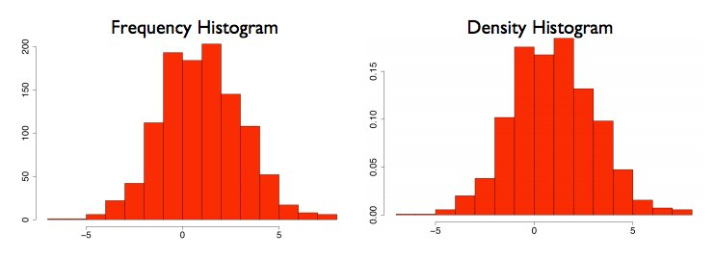
Frequency vs. Density Histograms
Dividing counts by the total yields a probability density plot, which is more interpretable:
Notes:
From http://www.gs.washington.edu/academics/courses/akey/56008/lecture/lecture2.pdf

Slide 30
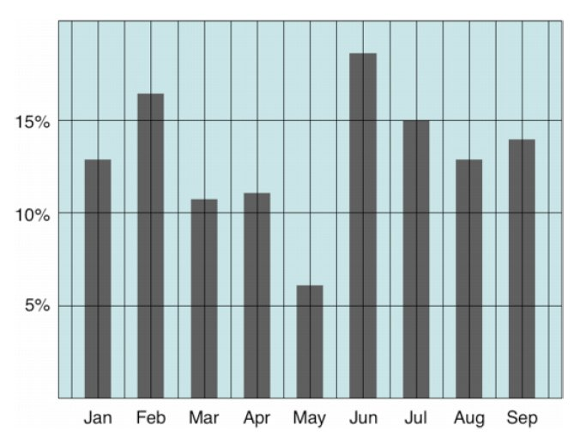
Can you Simplify this Plot?
Tim Brey
Notes:
From Harvard lecture 3, credited to Tim Brey

Slide 31
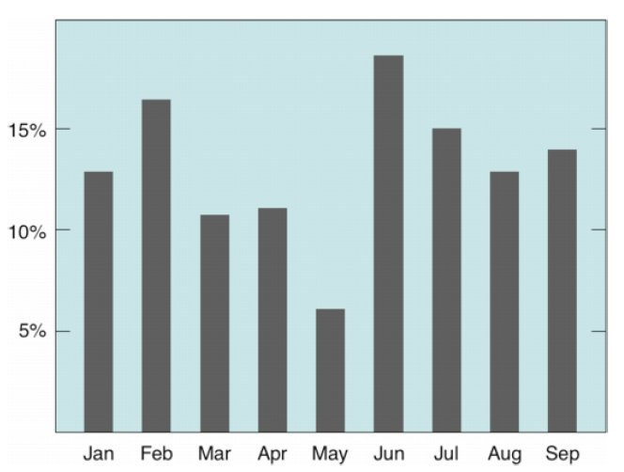
Can You Further Simplify?

Slide 32
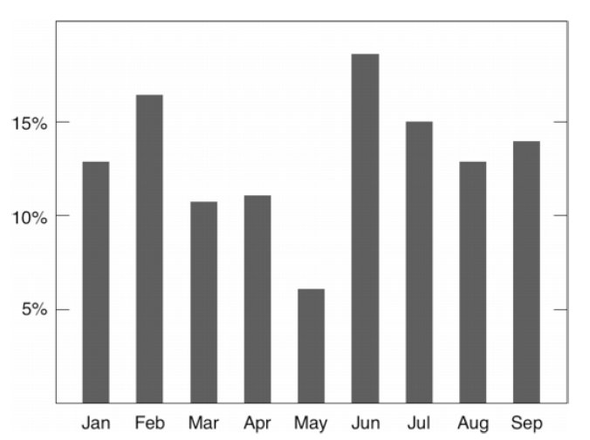
Better, but can you Further Simplify?

Slide 33
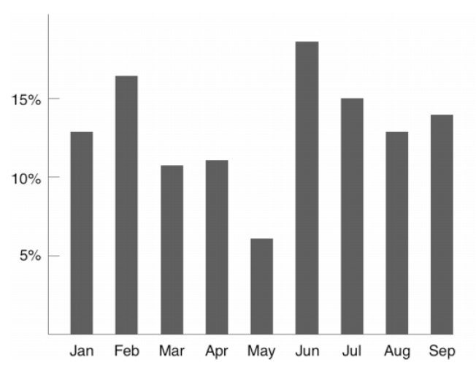
Anything Else that Can Go?

Slide 34
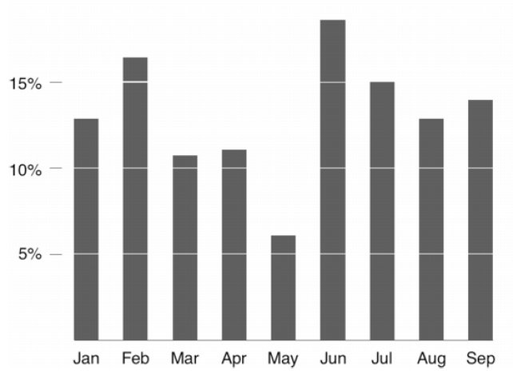
``Less is More’’

Slide 35
Which Chart to use?

Slide 36
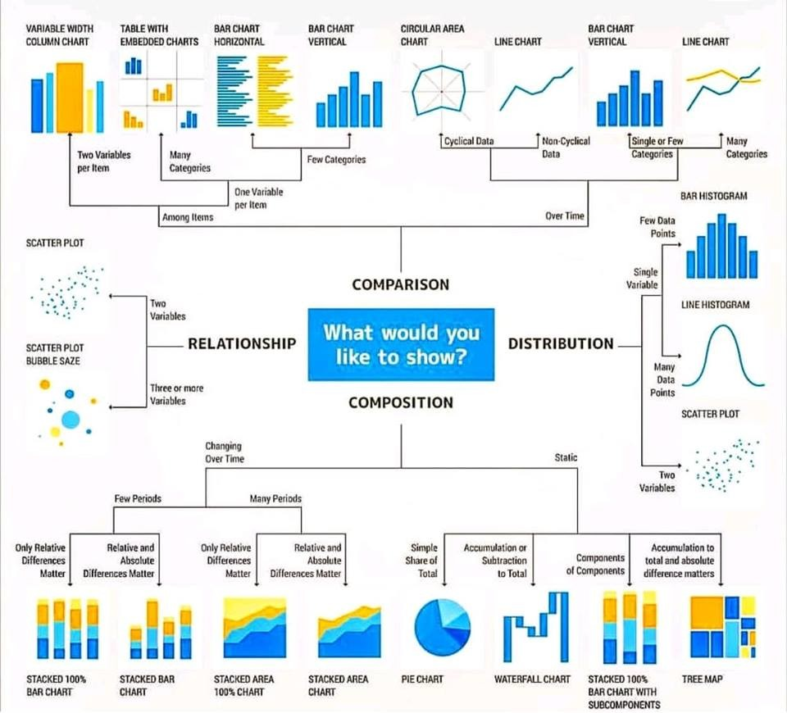
Source: ExtremePresentation.com

Slide 37
When to use Tables for Visualization

Slide 38
Tabular Data
Tables can have advantages over plots:
Representation of numerical precision
Understandable multivariate visualization: each column is a different dimension.
Representation of heterogeneous data
Compactness for small numbers of points.

Slide 39
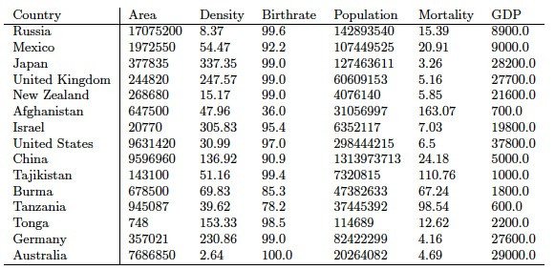
Can this Table be Improved?

Slide 40
Dimensions for Improvement
Order rows to invite comparisons.
Order rows to highlight importance or pairwise relationships.
Right justify uniform-precision numbers
Use emphasis, font, or color to highlight important entries.
Avoid excessive-length column descriptors.

Slide 41
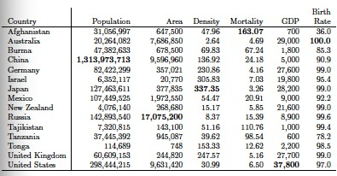
Improved Tabular Presentation

Slide 42
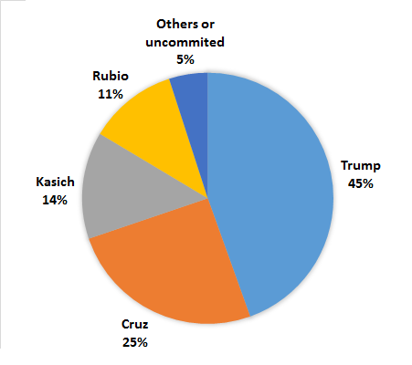
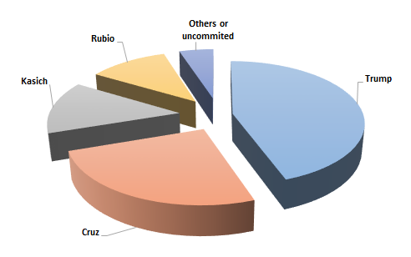
Which Pie Chart is Better?

Slide 43
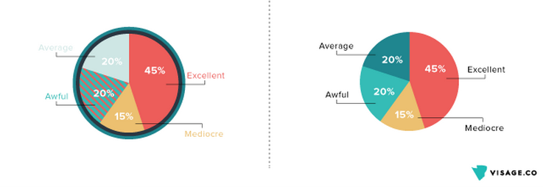
Which is better?
Source:Screen-Shot-2015-01-21-at-4.46.09-PM.png

Slide 44
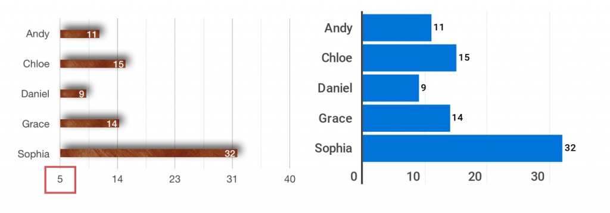
Which bar chart is better?
Source:dothisnotthat-bar-chart-1-1-1024x486.png

Slide 45
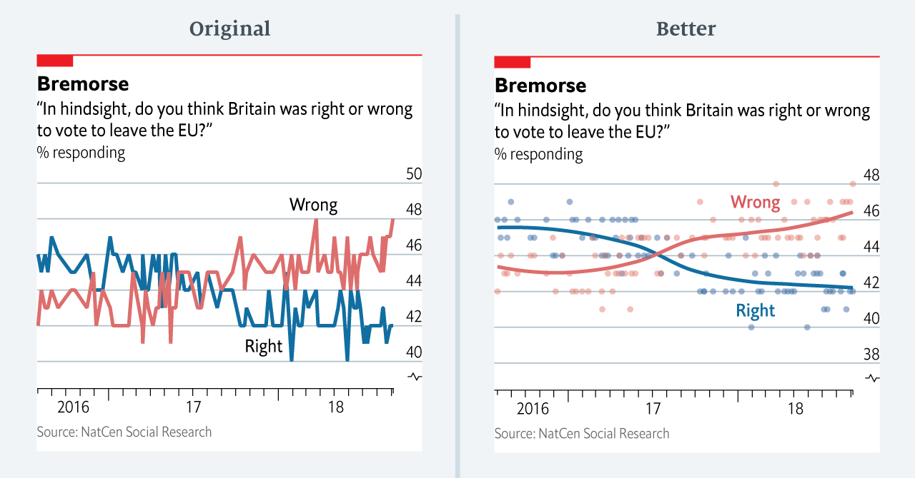
Which is better?

Slide 46
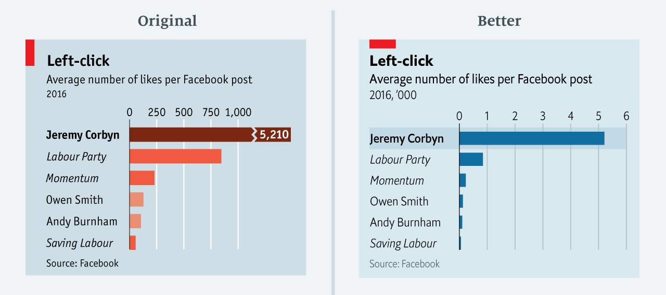
Which is better?
Source:1*9QE_yL3boSLqopJkSBfL5A.png

Slide 47
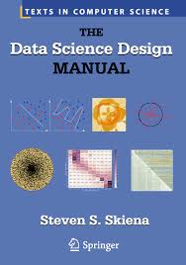
Reading for this week
The book is available online through the library [here]

